Slide 1

Indian Agriculture Analysis
By Ashish Mishra

Slide 2
Introduction
With a rich history spanning thousands of years, agriculture is the foundation of the Indian economy. It is essential to millions of people's livelihoods and makes a substantial contribution to employment, food security, and general economic growth. India is home to a vast array of crops that are cultivated in various parts of the country due to its various climatic zones, rich soil, and plentiful water supplies. India's agricultural industry is diverse, with a broad range of crops grown there, such as cereals, pulses, oilseeds, fruits, vegetables, spices, and cash crops. Among the main crops grown in the nation are sugarcane, rice, wheat, maize, millets, and pulses. Furthermore, with a wide range of horticultural products, India is among the world's top producers of fruits and vegetables.

Slide 3
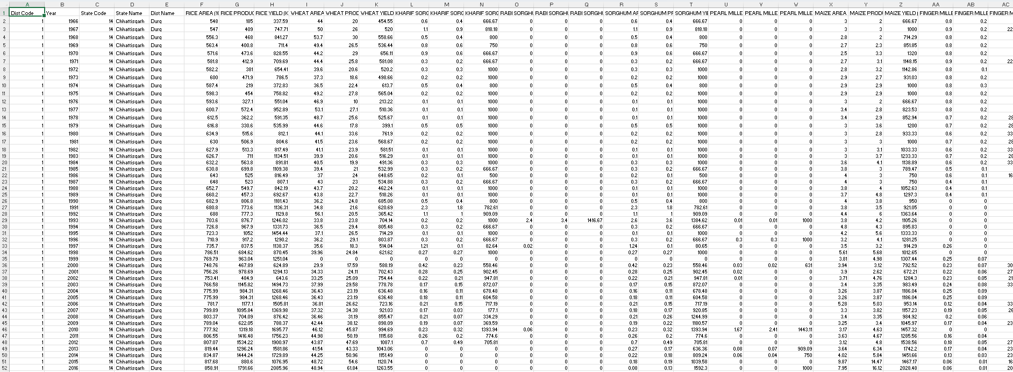
District Level Data

Slide 4
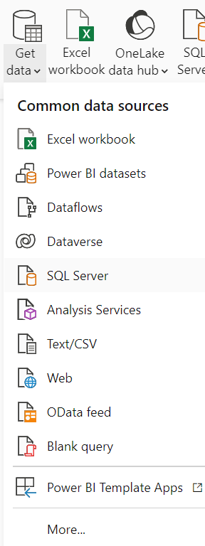
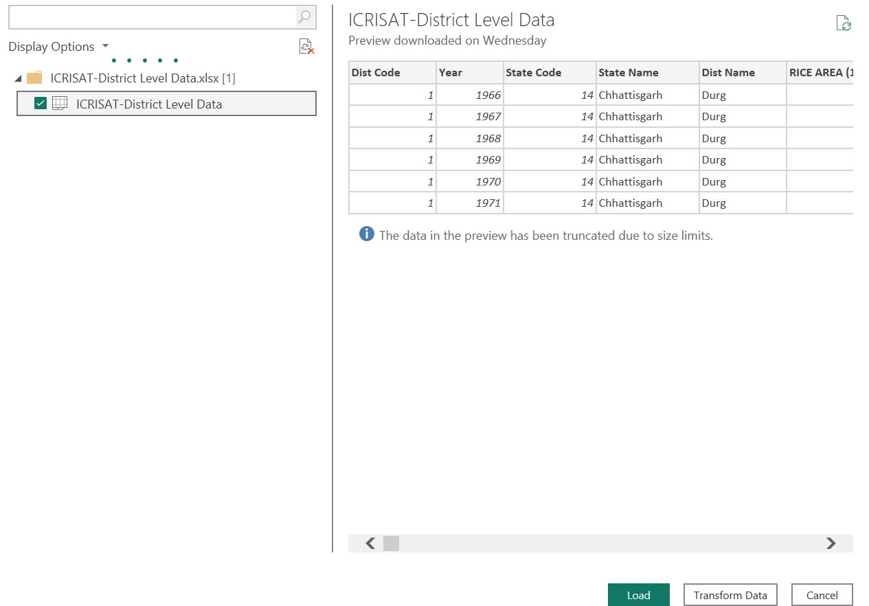
Data Overview

Slide 5
Transformation Data
Power BI

Slide 6
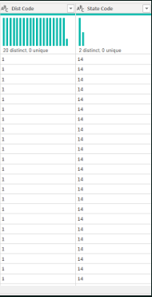
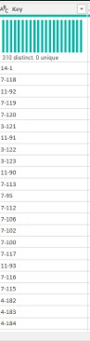
Merge District Code and State Code To make a key

Slide 7
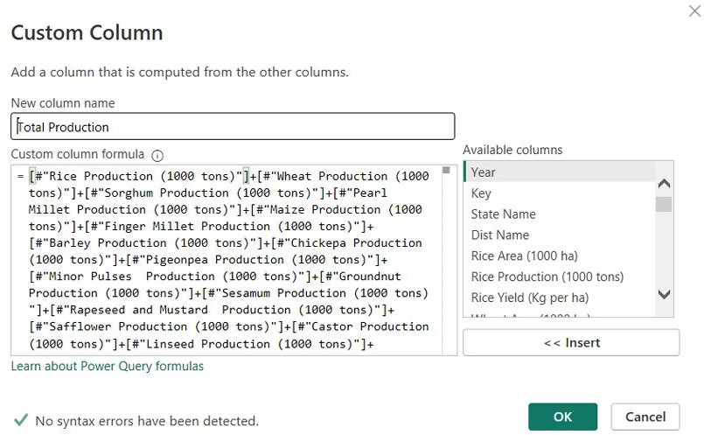
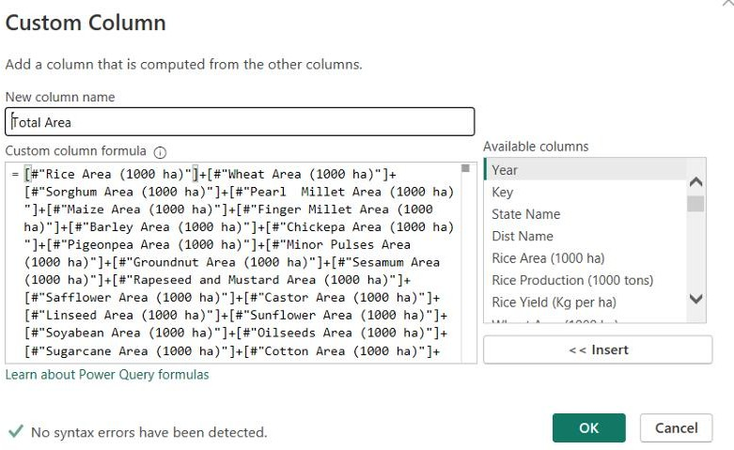
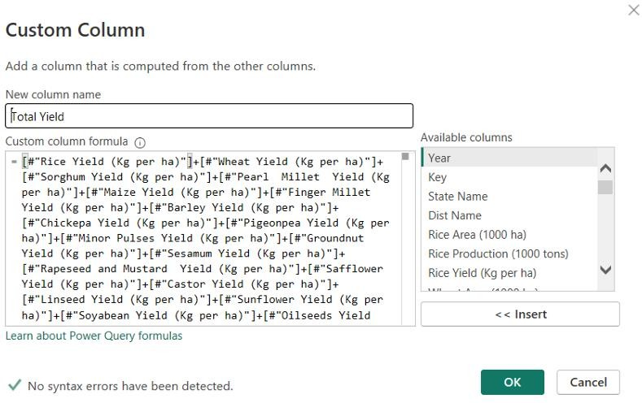
Add Custom column Total Area, Production, Yield

Slide 8
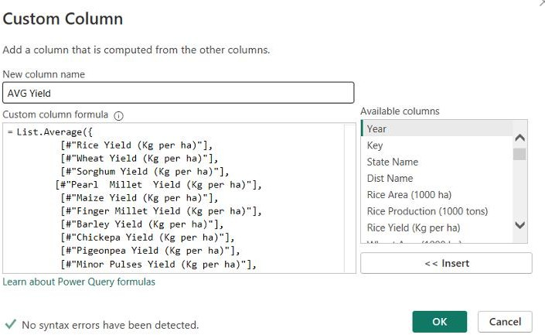
Add Custom columns Average production, Area, Yield

Slide 9
Data modeling

Slide 10
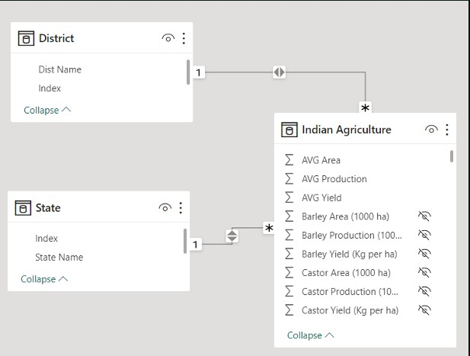
Data Model of Indian Agriculture Dataset

Slide 11
Data Visualization

Slide 12
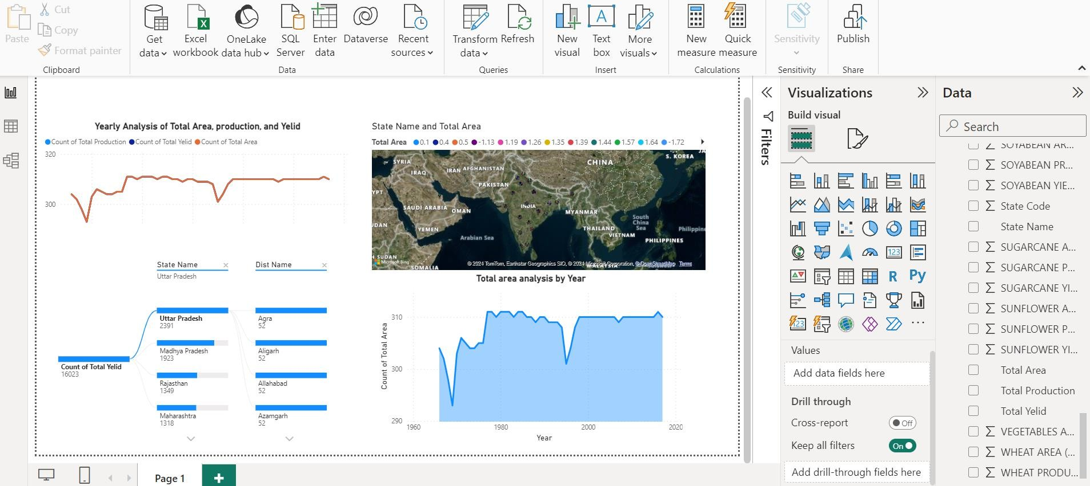
Agriculture Overview

Slide 13
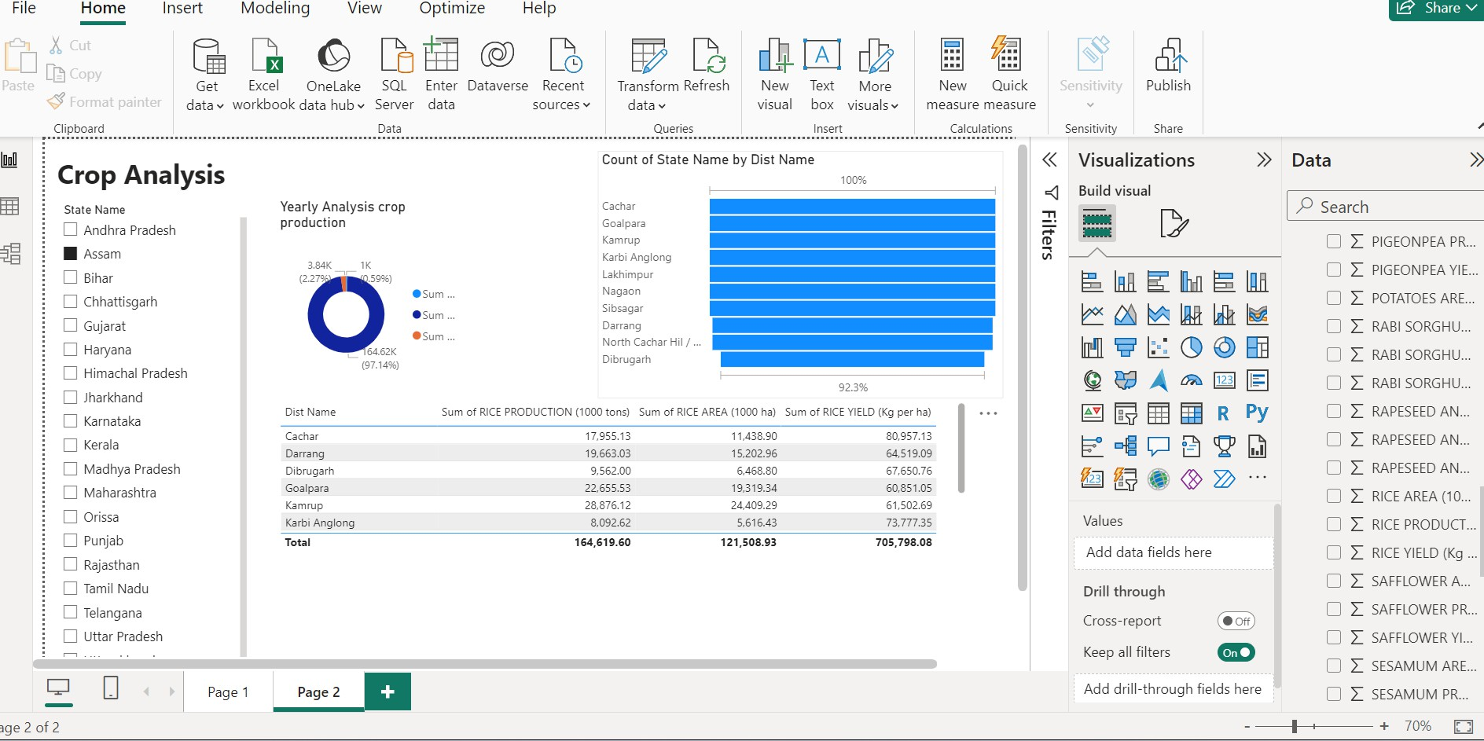
Crops Analysis

Slide 14
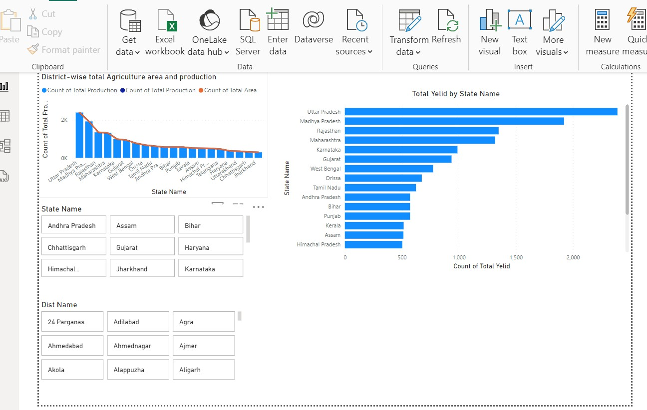
Regional Disparities

Slide 15
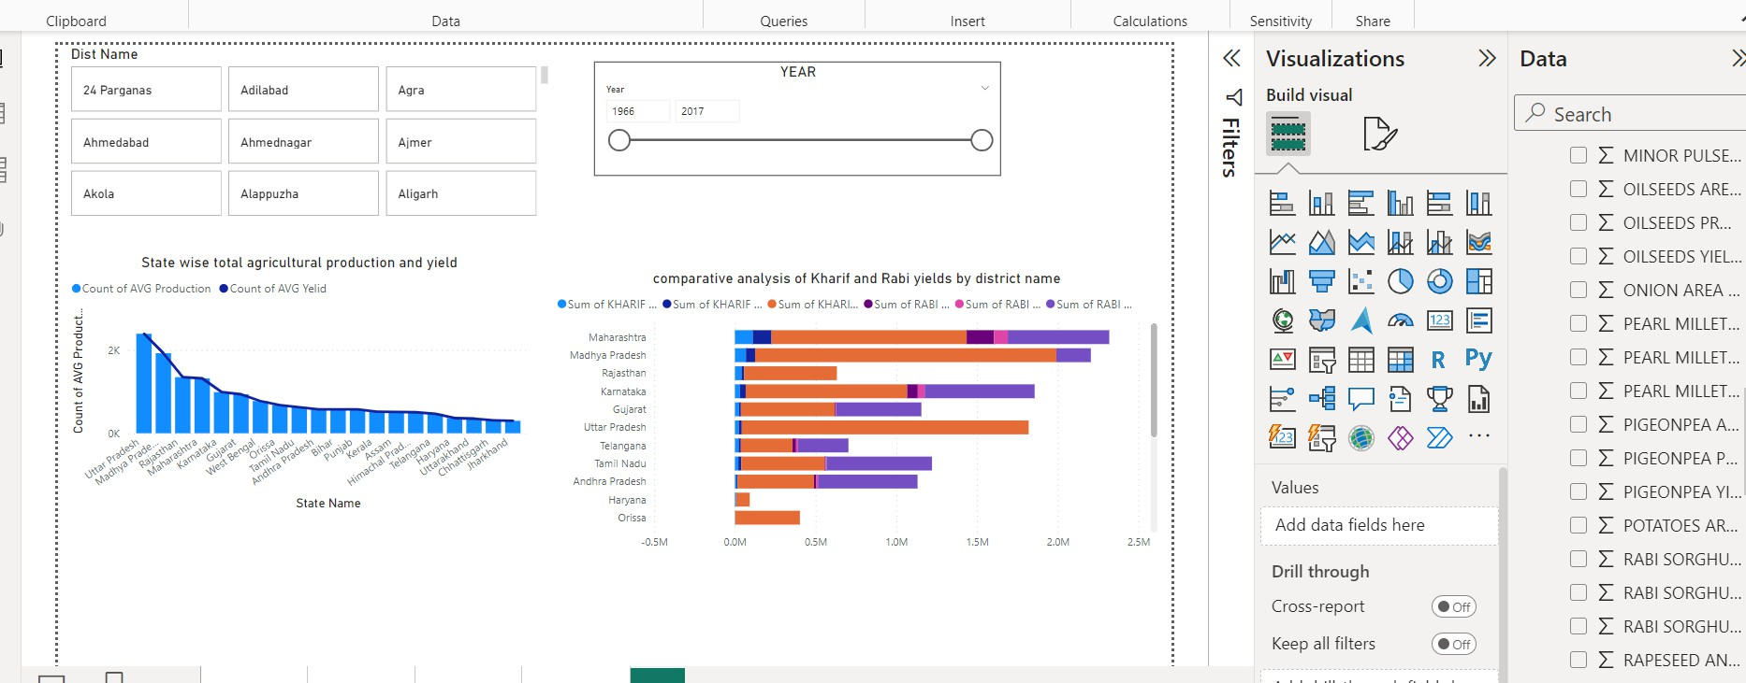
Seasonal Analysis

Slide 16
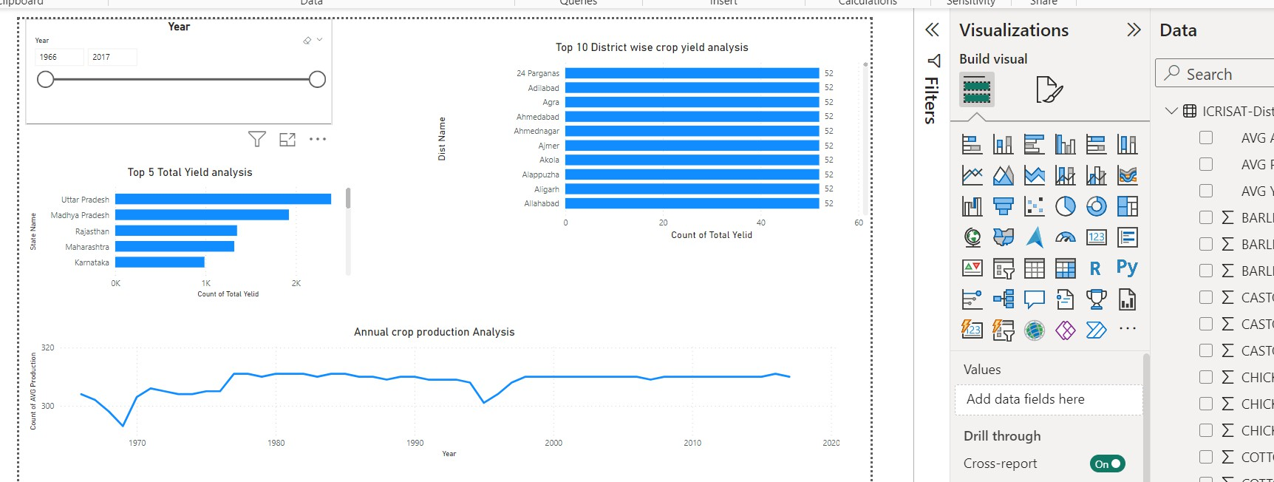
Impact of External Factors

Slide 17
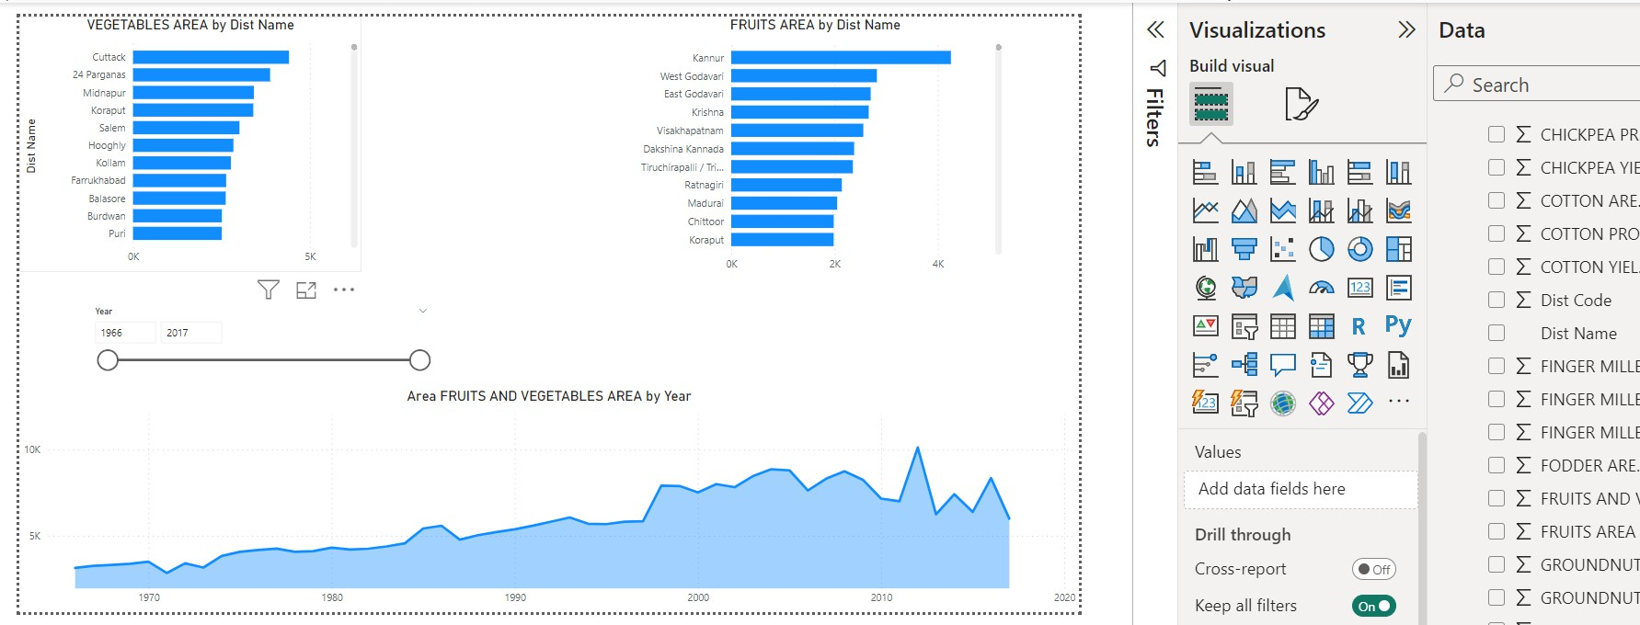
Fruits and Vegetables Analysis

Slide 18
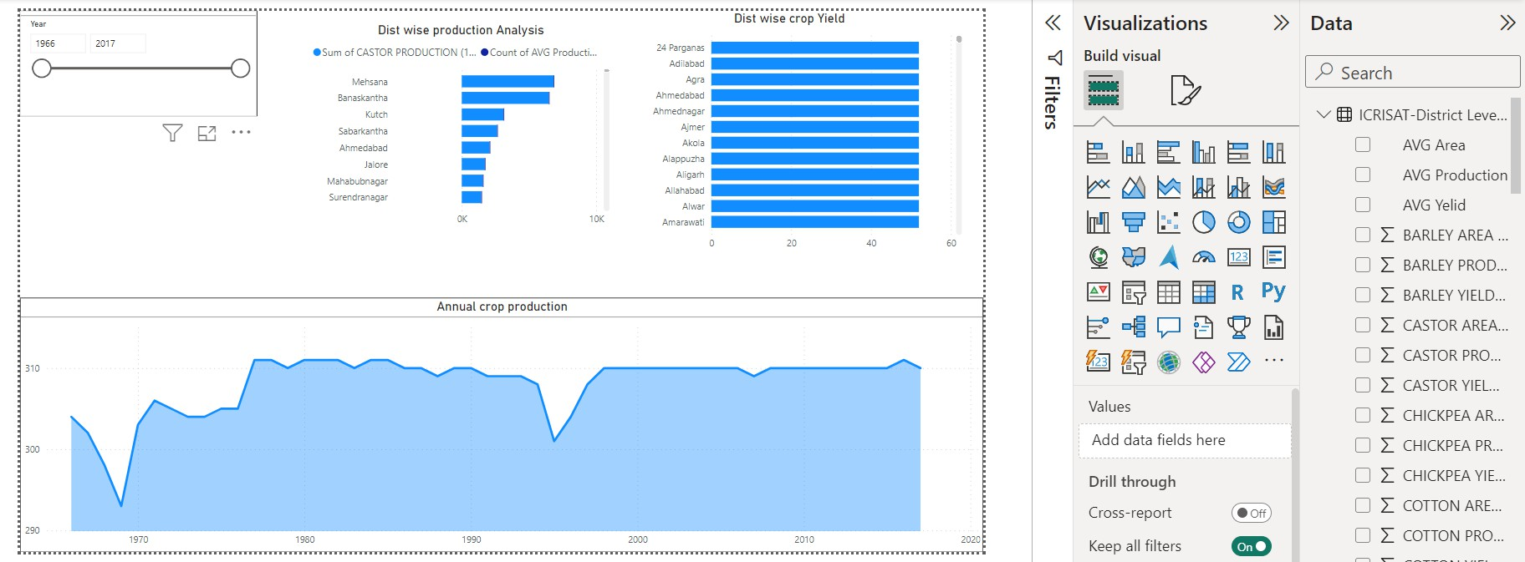
Sustainable Farming Insights

Slide 19
Summary
In overall, stakeholders are empowered with actionable insights through the Indian Agriculture Data Visualization project in Power BI, allowing them to improve agricultural production, resilience, and sustainability. Stakeholders can drive informed decision-making, manage difficult agricultural obstacles, and progress Indian agriculture with the use of intuitive visualizations.

Slide 20
THANK YOU

